Slide 1
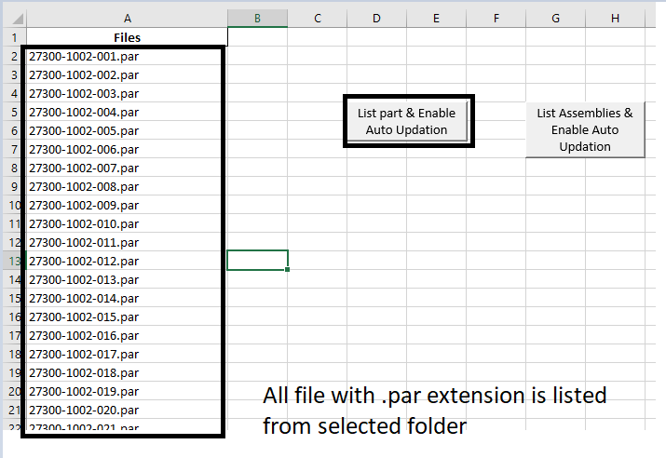
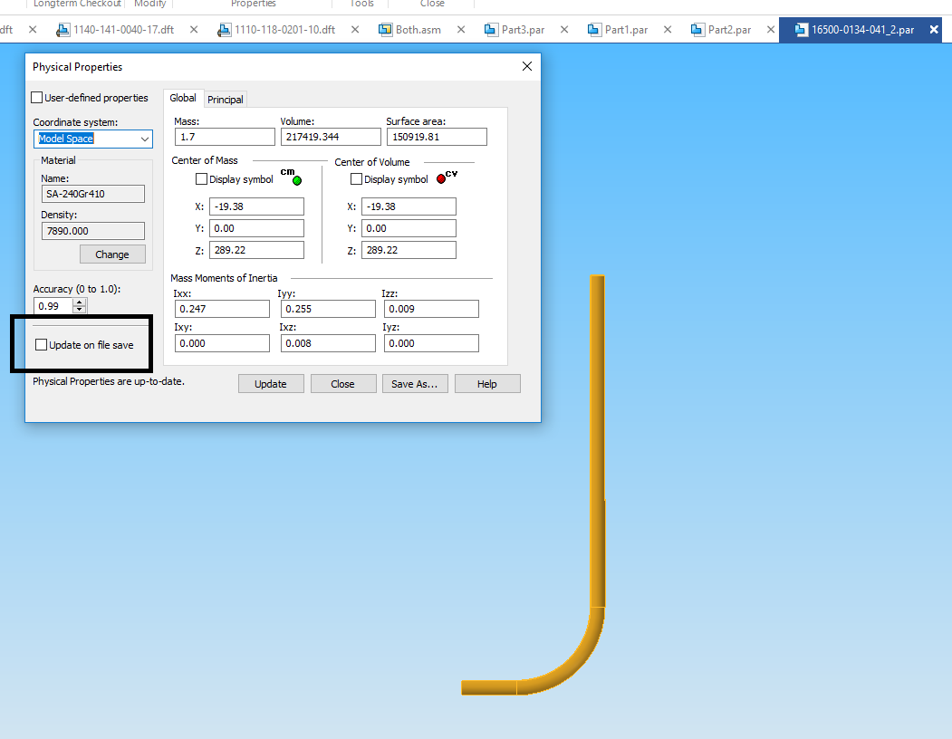
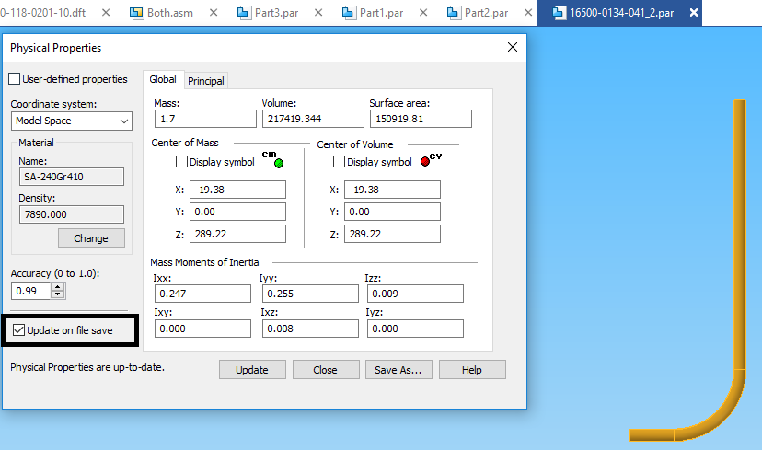
Solid Edge Part & Assembly Physical Property feature enabling
Description | A tool for automatic Ticked on “Update On File Save” property of solid edge part & assembly Physical property using macro.
Areas Impacted | Solid edge Part Model/assembly
Core Issues to be addressed | Manual Checks input in all parts and sub assemblies was required for proper updation of weight of part & assembly file.
Benefits | Automatic update weight when part modifies Less mis-matching in total weight in E-BOM, So no. of revision can be minimised.
Platform | MS Excel VBA
Scalable | Yes, All solid edge files except Draft and Config. files Can be listed at once(one click of button)

